Slide 1
CDI Resolución de Ejercicios

Slide 2
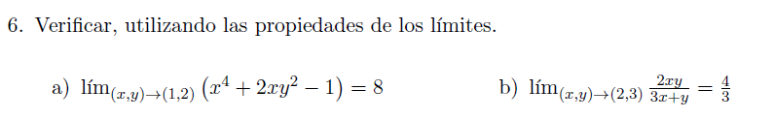




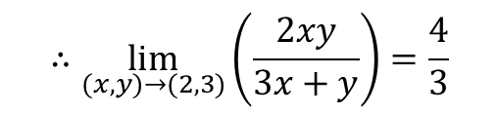

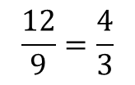

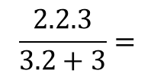
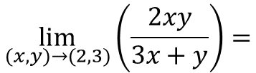
$$\lim_{(x,y)→(1,2)}{(x^{4}+2xy^{2}−1)}=$$
$$1^{4}+2.1.2^{2}−1=$$
$$1+8−1=8$$
$$∴\lim_{(x,y)→(1,2)}{(x^{4}+2xy^{2}−1)}=8$$
$$\lim_{(x,y)→(2,3)}\left(\frac{2xy}{3x+y}\right)=$$
$$\frac{2.2.3}{3.2+3}=$$
$$\frac{12}{9}=\frac{4}{3}$$
$$∴\lim_{(x,y)→(2,3)}\left(\frac{2xy}{3x+y}\right)=\frac{4}{3}$$

Slide 5
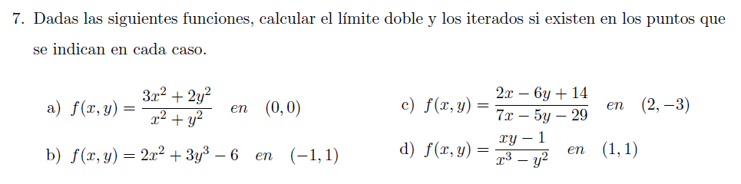

Slide 6




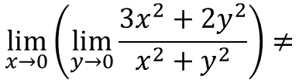
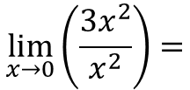


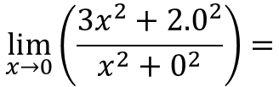
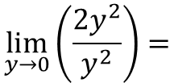
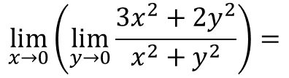
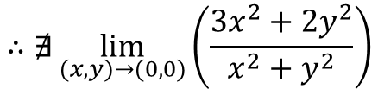
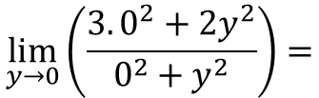
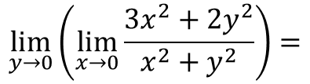
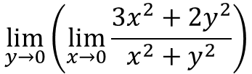
Cálculo de limites iterados
$$\lim_{x→0}\left(\lim_{y→0}{\frac{3x^{2}+2y^{2}}{x^{2}+y^{2}}}\right)=$$
$$\lim_{x→0}\left(\frac{3x^{2}+2{.0}^{2}}{x^{2}+0^{2}}\right)=$$
$$\lim_{x→0}\left(\frac{3x^{2}}{x^{2}}\right)=$$
$$\lim_{x→0}{3}=3$$
$$\lim_{y→0}\left(\lim_{x→0}{\frac{3x^{2}+2y^{2}}{x^{2}+y^{2}}}\right)=$$
$$\lim_{y→0}\left(\frac{3.0^{2}+2y^{2}}{0^{2}+y^{2}}\right)=$$
$$\lim_{y→0}\left(\frac{2y^{2}}{y^{2}}\right)=$$
$$\lim_{y→0}{2}=2$$
$$\lim_{x→0}\left(\lim_{y→0}{\frac{3x^{2}+2y^{2}}{x^{2}+y^{2}}}\right)≠$$
$$\lim_{y→0}\left(\lim_{x→0}{\frac{3x^{2}+2y^{2}}{x^{2}+y^{2}}}\right)$$
Como:
$$∴∄\lim_{(x,y)→(0,0)}\left(\frac{3x^{2}+2y^{2}}{x^{2}+y^{2}}\right)$$

Slide 7












$$\lim_{(x,y)→(−1,1)}\left(2x^{2}+3y^{3}−6\right)=$$
$$2{.(−1)}^{2}+3{.1}^{3}−6=−1$$
Cálculo de limites iterados
$$\lim_{x→−1}\left(\lim_{y→1}{2x^{2}+3y^{3}−6}\right)=$$
$$\lim_{x→−1}\left(2x^{2}+3{.1}^{3}−6\right)=$$
$$\lim_{x→−1}\left(2x^{2}−3\right)=$$
$$2{.(−1)}^{2}−3=−1$$
$$\lim_{y→1}\left(\lim_{x→−1}{2x^{2}+3y^{3}−6}\right)=$$
$$\lim_{y→1}\left(2{.(−1)}^{2}+3y^{3}−6\right)=$$
$$\lim_{y→1}\left(3y^{3}−4\right)=$$
$$2{.1}^{3}−4=−1$$
$$∴\lim_{(x,y)→(−1,1)}\left(2x^{2}+3y^{3}−6\right)=−1$$

Slide 8



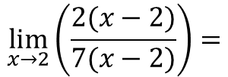
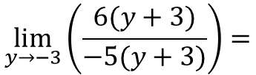
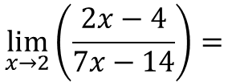
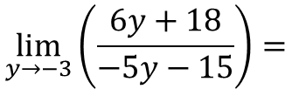
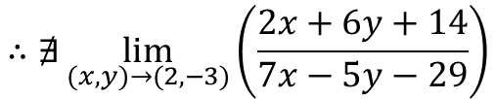
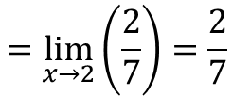
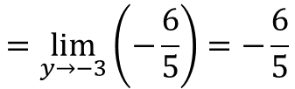
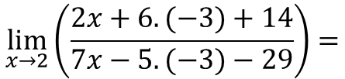
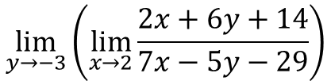
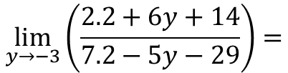
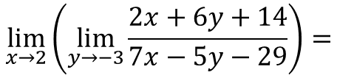
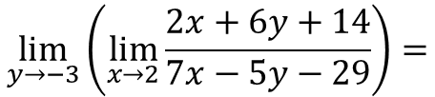
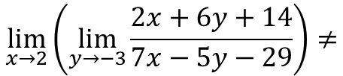
Cálculo de limites iterados
$$\lim_{x→2}\left(\lim_{y→−3}{\frac{2x+6y+14}{7x−5y−29}}\right)=$$
$$\lim_{x→2}\left(\frac{2x+6.(−3)+14}{7x−5.(−3)−29}\right)=$$
$$\lim_{x→2}\left(\frac{2x−4}{7x−14}\right)=$$
$$\lim_{x→2}\left(\frac{2(x−2)}{7(x−2)}\right)=$$
$$=\lim_{x→2}\left(\frac{2}{7}\right)=\frac{2}{7}$$
$$\lim_{y→−3}\left(\lim_{x→2}{\frac{2x+6y+14}{7x−5y−29}}\right)=$$
$$\lim_{y→−3}\left(\frac{2.2+6y+14}{7.2−5y−29}\right)=$$
$$\lim_{y→−3}\left(\frac{6y+18}{−5y−15}\right)=$$
$$\lim_{y→−3}\left(\frac{6(y+3)}{−5(y+3)}\right)=$$
$$=\lim_{y→−3}\left(−\frac{6}{5}\right)=−\frac{6}{5}$$
Como:
$$\lim_{x→2}\left(\lim_{y→−3}{\frac{2x+6y+14}{7x−5y−29}}\right)≠$$
$$\lim_{y→−3}\left(\lim_{x→2}{\frac{2x+6y+14}{7x−5y−29}}\right)$$
$$∴∄\lim_{(x,y)→(2,−3)}\left(\frac{2x+6y+14}{7x−5y−29}\right)$$

Slide 9
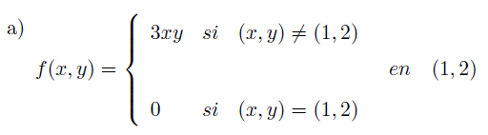
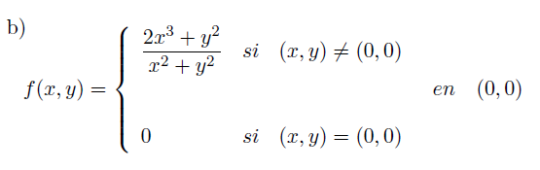

Slide 10






Cálculos auxiliares
$$\lim_{\left(x,y\right)→\left(1,2\right)}\left(3xy\right)=3.1.2=6$$
$$∃f\left(1,2\right)=0$$
Por como esta definida la función
$$∃\lim_{\left(x,y\right)→\left(1,2\right)}\left(3xy\right)=6$$
$$\lim_{\left(x,y\right)→\left(1,2\right)}\left(3xy\right)≠f\left(1,2\right)$$

Slide 11


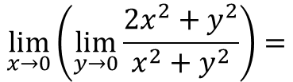
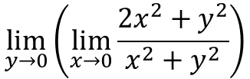
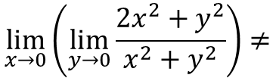

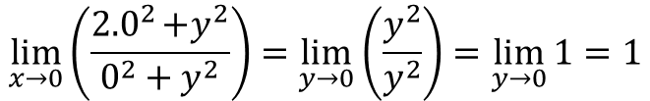
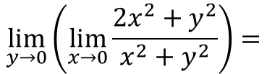
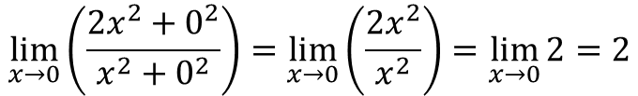
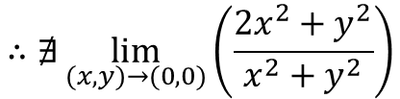
$$∃f\left(0,0\right)=0$$
Por como esta definida la función
Cálculos auxiliares
$$\lim_{x→0}\left(\lim_{y→0}{\frac{2x^{2}+y^{2}}{x^{2}+y^{2}}}\right)=$$
$$\lim_{x→0}\left(\frac{2x^{2}+0^{2}}{x^{2}+0^{2}}\right)=\lim_{x→0}\left(\frac{2x^{2}}{x^{2}}\right)=\lim_{x→0}{2}=2$$
$$\lim_{y→0}\left(\lim_{x→0}{\frac{2x^{2}+y^{2}}{x^{2}+y^{2}}}\right)=$$
$$\lim_{x→0}\left(\frac{2{.0}^{2}+y^{2}}{0^{2}+y^{2}}\right)=\lim_{y→0}\left(\frac{y^{2}}{y^{2}}\right)=\lim_{y→0}{1}=1$$
$$\lim_{x→0}\left(\lim_{y→0}{\frac{2x^{2}+y^{2}}{x^{2}+y^{2}}}\right)≠$$
$$\lim_{y→0}\left(\lim_{x→0}{\frac{2x^{2}+y^{2}}{x^{2}+y^{2}}}\right)$$
$$∴∄\lim_{(x,y)→(0,0)}\left(\frac{2x^{2}+y^{2}}{x^{2}+y^{2}}\right)$$
Como:

